Slide 1


ESF #8 Patient Movement
Specialty Teams
A NATION PREPARED
ó ó
Ken Hopper
Federal Patient Movement Coordinator
Operations Division
Office of Emergency Management
Assistant Secretary, Prepardeness and Response
OFFICE OF THE ASSISTANT SECRETARY FOR PREPAREDNESS AND RESPONSE

Slide 2
Overview
Mobile Acute Care Teams (MAC T)
Service Access Teams (SAT)

Slide 3
MAC T Mission
Provide critical care augmentation during patient evacuation, primarily to DoD
  Transfer care to CCATTs
Provide critical care augmentation to medical facilities impacted by a disaster
Primary mission is support for evacuation mission

Slide 4
MAC-T Personnel Complement (22)
Team Chief [1]
MAC Team [14]
  Medical Lead (critical care physician) [2]
  Medical Officer (critical care or emergency medicine physicians [2]
  Nursing Lead (Critical Care RN) [2]
  Nurse (CCRN / ER / Post-Anesth RN) [6]
  Respiratory Therapist [2]
Pharmacist [1]
Logistics / Comm Specialist [2]
Joint Patient Tracking Team [4]
CCATT Team Member

Slide 5
Direction and Control at the APOE
DASF Force Module (including MAC T) reports to the Director of Patient Staging
Director of Patient Staging has operational control of the MAC T once in place at the APOE
  Reporting requirements to IRCT Patient Movement Branch
Incident Response Coordination Team (IRCT) maintains administrative control

Slide 6
“Organization Chart”
HQ HHS
SOC / EMG
US Northern Command
US Transportation Command
618
Tactical Airlift
Control Center
ESF #8 Lead
AE
Command Sqdn
IRCT
Director of
Patient Staging
MAC T
& other
HHS personnel
MASF
DoD Personnel
DASF

Slide 7
MAC T Equipment and Supplies
Started with two Critical Care Air Transport Team Equipment sets
  Added additional drugs, supplies, IVs, and specialty equipment
Patient Movement Items (PMI)
  Ventilators, Suction, Propaks, Infusion Pumps, PCA pumps,
Vent and oxygen requirements
Universal precautions PPE and hearing protection

Slide 8

MAC T Training
All MAC T personnel attend:
  MAC T Basic Course
  MAC T Advanced Course
All MAC T Team leads attend Team Lead training
Additional opportunities include regional exercises, National Level Exercises and DoD/NGB training events

Slide 9

MAC T Developments
MAC Strike Team CONOPS signed in September 2011
  Training requirements
  Team structure
  Find it on the SOC Portal
DASF with MAC ST CONOPS (authored by DoD) signed in December 2011
  Describes relationships, roles and responsibilities, and C2 for both DASF and HHS assets at an APOE
Changed name from MAC ST to MAC T to comply with ICS
MAC ST
CONOPS
DASF
w/ MAC ST
CONOPS

Slide 10
MAC T Developments, cont.
Develop rotation schedule; teams will be of a “rainbow” configuration (i.e., not from the same team)
  Teams will be entered into RMS and have on-call schedule
  Readiness status reported to leadership during weekly Readiness briefs
  On-call schedule worked by PDB and Field Ops
Establish in-house training program
Purchase four “Critical Care Caches”/equipment sets
  Mirrors most of AF CCATT set
  Additional supplies
    Pharmaceuticals
    Rolling Litters

Slide 11








Patient Movement
Current Readiness Status
On Call | MAC-ST | JPATS | SAT
Feb 2012 | AL-3 CA-2 CA-11 MA-2 | AL-1 LA-1 OH-1 PA-3 | SAT #4
Mar 2012 | AR-1 CA-4 IMSuRT-W MD-1 | FL-1 OH-5 RI-1 SC-1 | SAT #5
#1
#2
#3
#4
APOE
P
P
P
P
T
T
T
T
P
P
P
P
P
P
P
P
T
T
T
T
T
T
T
T
P | = | Personnel
T | = | Training
 | = | 90% – 100%
 | = | 80% – 89%
 | = | < 79%
FCC
P
P
P
P
P
P
P
P
T
T
T
T
T
T
T
T
P
P
P
P
P
P
P
P
T
T
T
T
T
T
T
T
Log Cache
HHS
HHS
DoD
DoD
APOE
APOE
APOE
APOE
APOD
APOD
APOD
APOD
APOD
APOD
No assigned cache, put together on as needed request

Slide 12
SAT Configuration
Five (5) teams of 18 U.S. Public Health Service officers
Scalable
Under the operational control of the IRCT Patient Movement Branch, Operations Section, when deployed, or the Emergency Management Group at HQ HHS
Staff can deploy to FCCs, State Health Emergency Coordination centers, State health departments, or specific shelters/hospitals where ever evacuees are located

Slide 13
SAT Responsibilities
SAT coordinates ALL aspects of patient return to ensure smooth transition from host State to final destination. Scope of services include:
  Work with FCCs, sending and receiving facilities, State EOCs and health departments to identify/track patients
  Ensure transportation, human services (language translation, food, lodging, etc) and arrangements for discharged patients and attendants
  Coordinate return of patients and attendants to home state
  Facilitate communication between attending physician and accepting physician for those requiring follow-on care

Slide 14
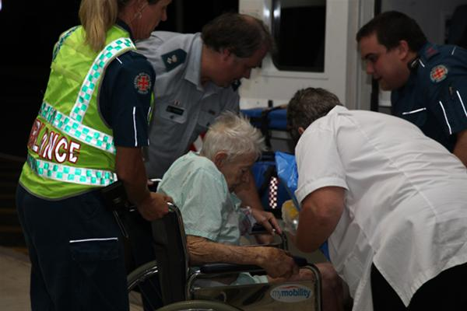
SAT Primary Functions
# 1 - Coordination of Evacuee Return
Desired end state is return to home or appropriate placement
Medical evacuees (and their non-medical attendants) are allowed to return when:
  They are well enough to travel
  The evacuated state has declared it is safe to return
  There is an appropriate receiving facility

Slide 15
Scope of Service:
Facilitating communication
Arranging transportation
Ensuring that the system is established to “re-enter” patients, as well as accompanying family members and non-medical attendants
Ensure that human services are provided during transport and as needed at the reception location

Slide 16

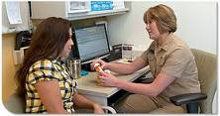
SAT Primary Functions
# 2 – Medical Case Management
Coordinate services with facility discharge planners, receiving facilities, others as required
Communicates clearly to patients, families, providers, and staff of receiving facility
Arranges for medical transportation/ equipment

Slide 17
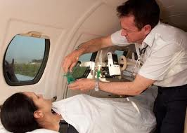
SAT Primary Functions
# 3 – Coordinate Evacuee Travel
SAT communicates with patient movement contractor or the ASPR Response Travel Section to arrange transportation
Movement may be through a variety of modes: air, train, ground
Arrange transportation services for non-medical attendants who accompanied patient

Slide 18

SAT Primary Functions
# 4 – Coordinate Human Services
Coordinate lodging and human services needs for discharged patients and attendents until transportation to their final destination can be facilitated
  Note: Family members that accompany patients or non-medical attendants will likely re-enter with patient and will require transportation that matches the patient
  Attendants or family members may return to their home of origin OR same location as the patient

Slide 19

SAT Primary Functions
# 5 – Data Collection
SAT works with medical facilities, nursing homes, rehabilitative services units who are providing care to evacuees
SAT personnel will have access to the Joint Patient Assessment Tracking System (JPATS). Once operational, responsible for updating JPATS until patients returned to final destination
Report daily to the IRCT, Emergency Management Group (EMG), state authorities, and hospitals
Coordination with appropriate local and state agencies

Slide 20
Non-patient Support
FEMA ESF #8 Mission Assignment to support provision of services to:
  Non-medical attendants
  Service animals
  Discharged patients who can’t immediately be returned
Services either under ESF #8 sub-tasking, or direct to HHS
Range of services to include clothing, hygiene products, service animals (food), hotel, food, and local transportation

Slide 21
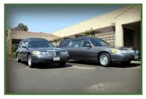
In Case of Death
If a patient dies during response operations – SAT will coordinate with appropriate local or State authorities and patient’s family for disposition of remains.

Slide 22
Summary
SATs are NOT case managers
Primary mission – to facilitate the return of ESF #8 patients to their home of record
Utilize JPATS to track patients and update status
Will execute the Re-entry Contract for patient movement

Slide 23
Questions?

