Slide 1
STROKE SMART MARYLAND
Stroke Smart Basics

Slide 2
Statistics
1 in 6 of us will suffer a stroke in our lifetime
Someone in the U.S. suffers a stroke every 40 seconds
Someone dies every 4 minutes from stroke
2 million brain cells die every minute during a stroke
Notes:
The odds get higher as we age, but anyone can have a stroke at any time.

Slide 3
The Good News
Definitive treatment is available!
Getting to the ER within 3 hours can save a life!
Most people don’t get to treatment in time
Notes:
We have the medicine to drastically reduce the death and extreme disability that comes with strokes. You can avoid that tragedy for yourselves and others from acting on this simple information presented here today.

Slide 4
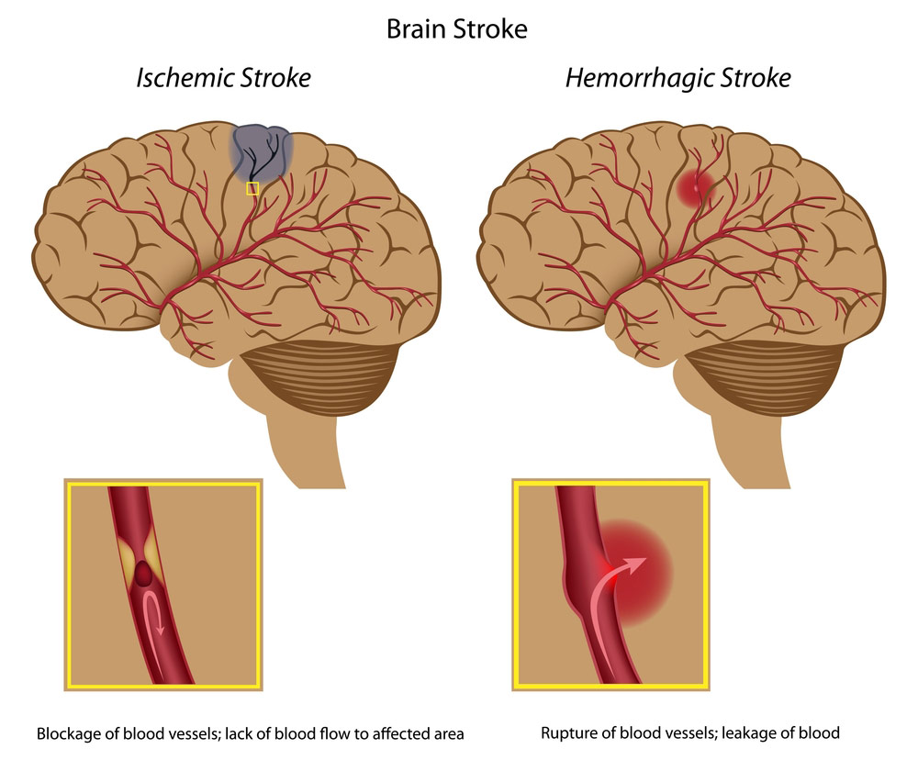
What is a Stroke?
Blood Interruption to the Brain
A stroke occurs when blood flow to brain cells is interrupted. Blood flow can be interrupted when a vessel bursts and when a blockage occurs in a blood vessel. The symptoms of both are similar as blood is interrupted to the cells past the break or blockage.

Slide 5
The Goal
Spot a stroke
Stop a Stroke
SAVE A LIFE!
You will leave here today with the knowledge and confidence to spot a stroke, stop a stroke, and save a life.

Slide 6
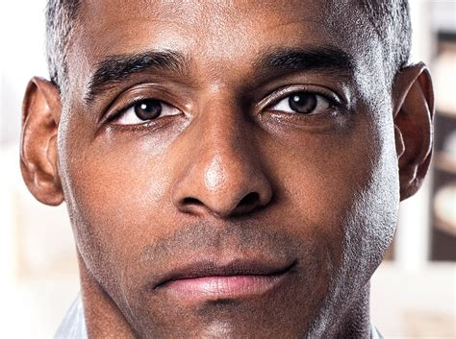
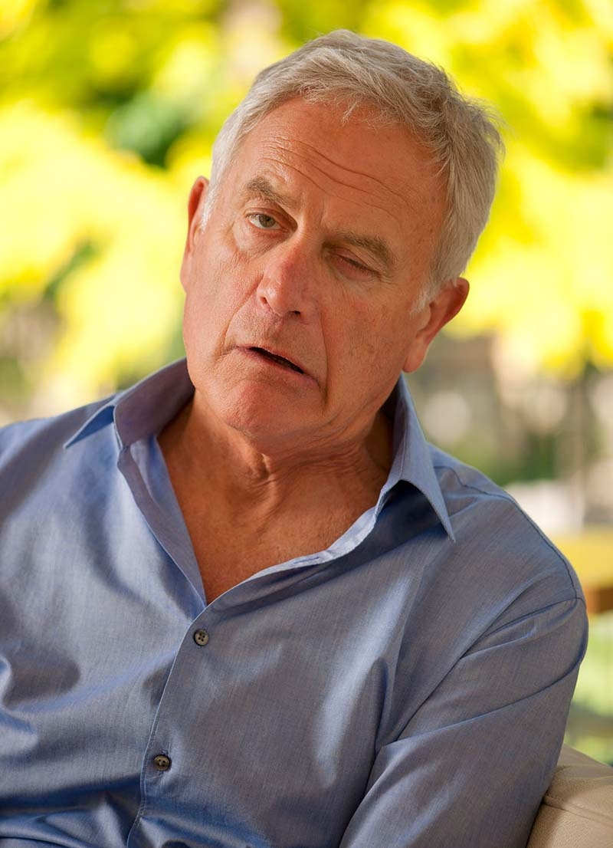
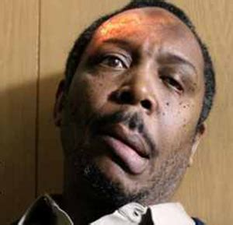
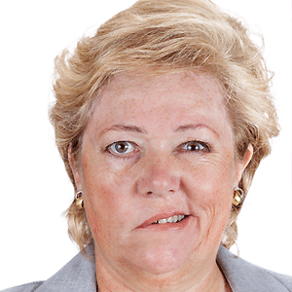
Spot a Stroke
Drooping face
Notes:
Roughly 70% of stroke patients will show a droopy face or one-sided arm weakness. These people are unable to smile with both sides of their faces due to the stroke. If they get to treatment in time, their chances of quick recovery are most likely.

Slide 7
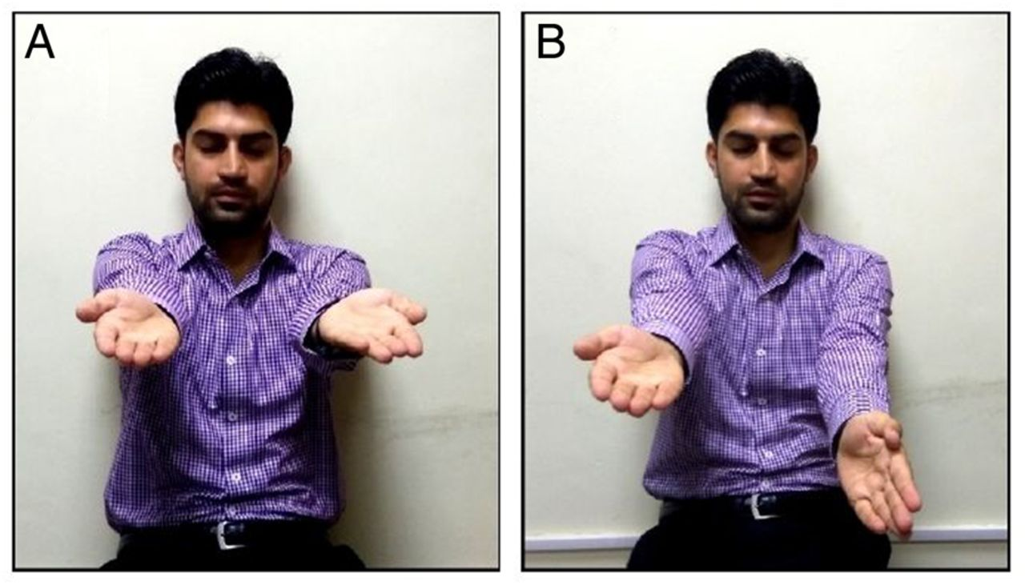
Spot a Stroke
Arm weakness
Notes:
This is the 2nd common sign most people suffering from strokes will have. They are often unable to raise both arms to the same level. One side is suddenly weak without a known reason. They may even think they are raising both arms equally. Not all stroke patients will show this sign, however.

Slide 8
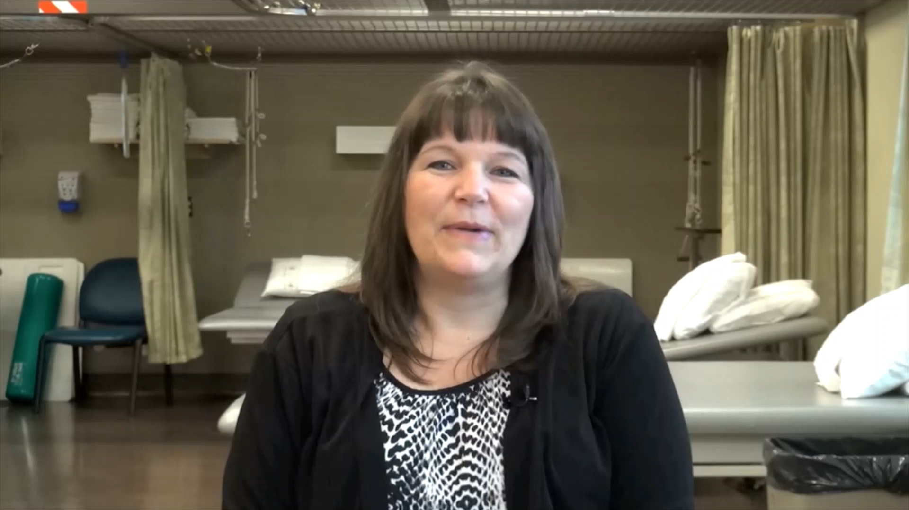
Spot a Stroke
Watch Video
Notes:
Stacy needed rehab. The goal of this talk is to ensure you get to definitive treatment in time, lessening your chances of needing rehab!

Slide 9
Spot a Stroke
Sudden, Unexplained Signs
Numbness on one or both sides of the body
Difficulty understanding of forming words
Confusion
Loss of balance/dizziness
Weakness on one or both sides of the body
Vision changes
Facial drooping
Notes:
Sudden, unexplained onset. Symptoms can come and go.

Slide 10
The Goal
#2: Stop a Stroke
Once you suspect the person might be having a stroke, you MUST take action to stop that stroke.
CALL 9-1-1!

Slide 11
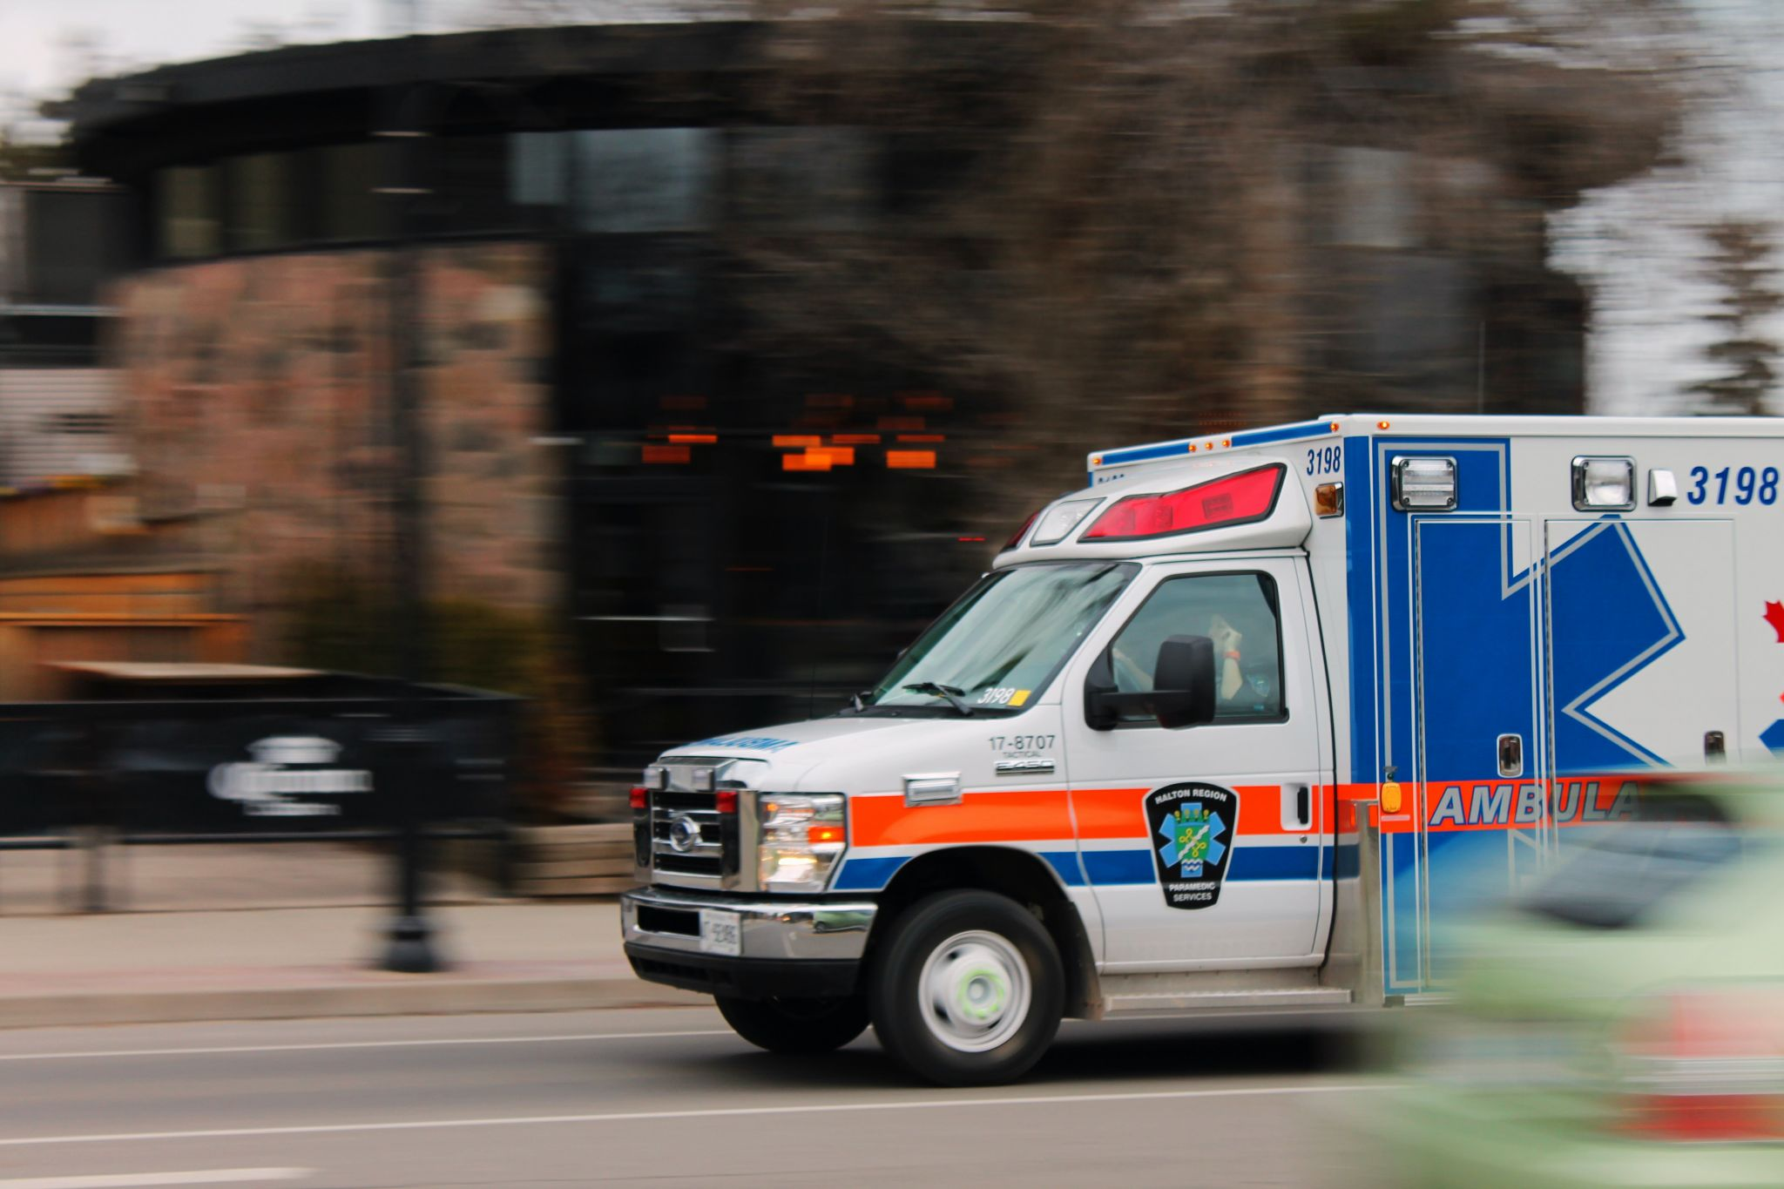
Stop a Stroke
CALL 9-1-1! Do Not:
Drive yourself to the ER
Call your primary care doctor
Lie down thinking it will pass
Notes:
Calling 911 is the fastest way to get the stroke patient to life saving treatment.

Slide 12
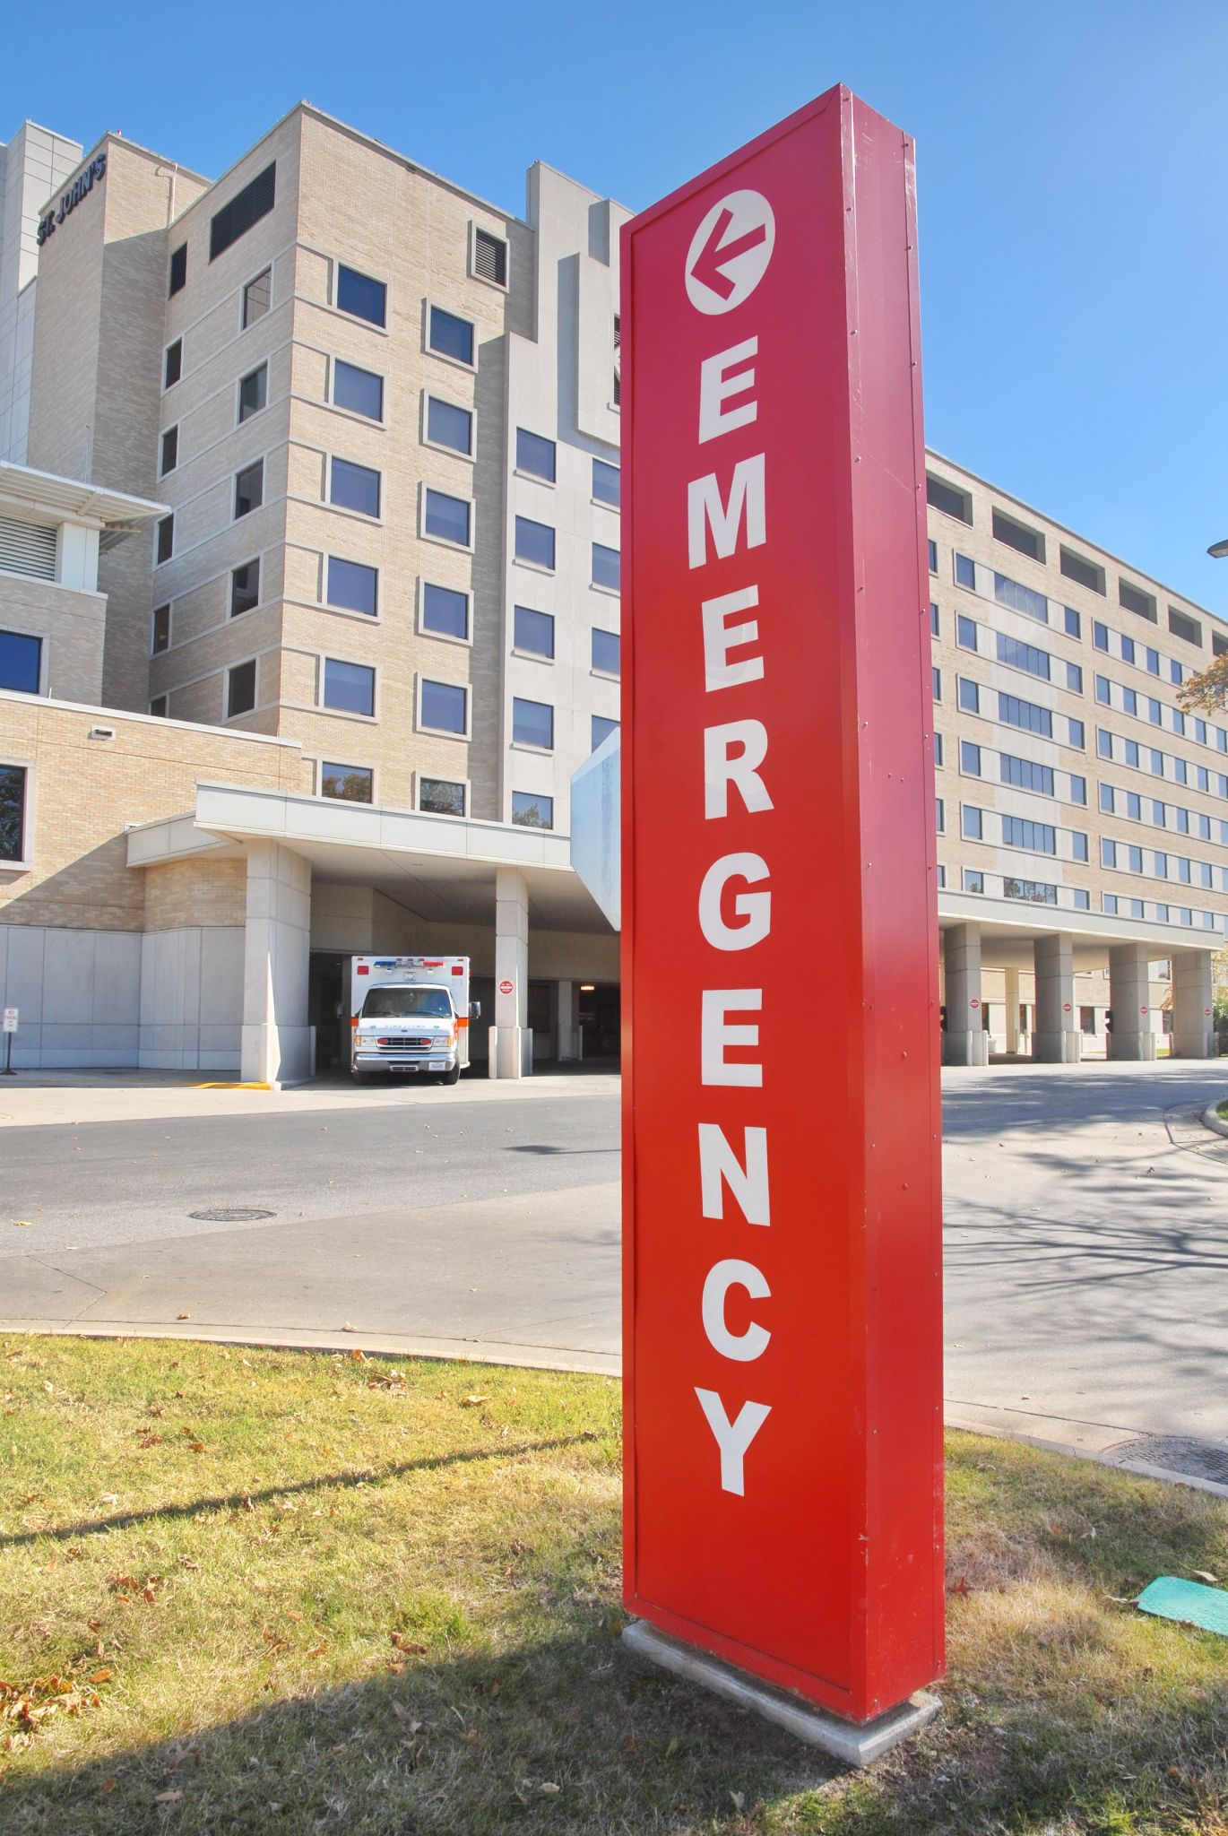
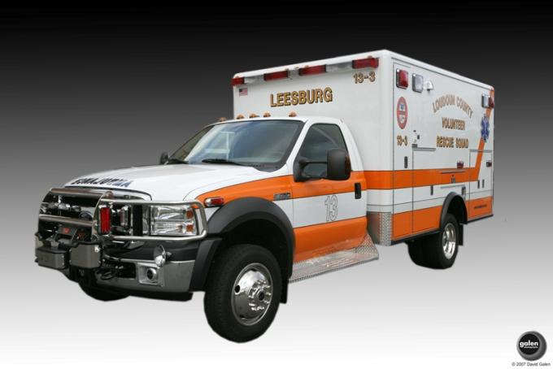
Stop a Stroke
There is no cost for just calling 9-1-1
Many stroke patients can't call 9-1-1 themselves
The cost of not calling 9-1-1 with a stroke is much higher
Notes:
The ambulance personnel do not get mad at you for calling them. It’s their job to respond.

Slide 13
The Goal
#3: SAVE A LIFE
Your action has the potential to drastically reduce disability and to save a life.

Slide 14
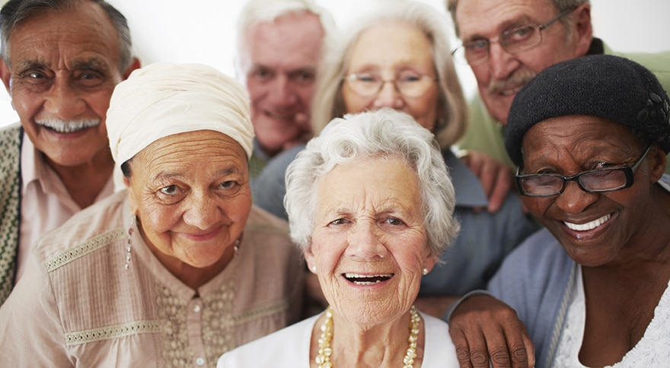
Save a Life
Norway study:
6 years, 613 patients
73 received treatment within 1 hour of symptoms
100% had ZERO deficits (no weakness, speech issues, etc.)
Notes:
Stacy needed rehab. The goal of this talk is to ensure you get to definitive treatment in time, lessening your chances of needing rehab!

Slide 15
The Goal
Spot a stroke
Stop a Stroke
SAVE A LIFE!
To summarize, you leave here today with the knowledge and confidence to spot a stroke, stop a stroke and save a life.

Slide 16
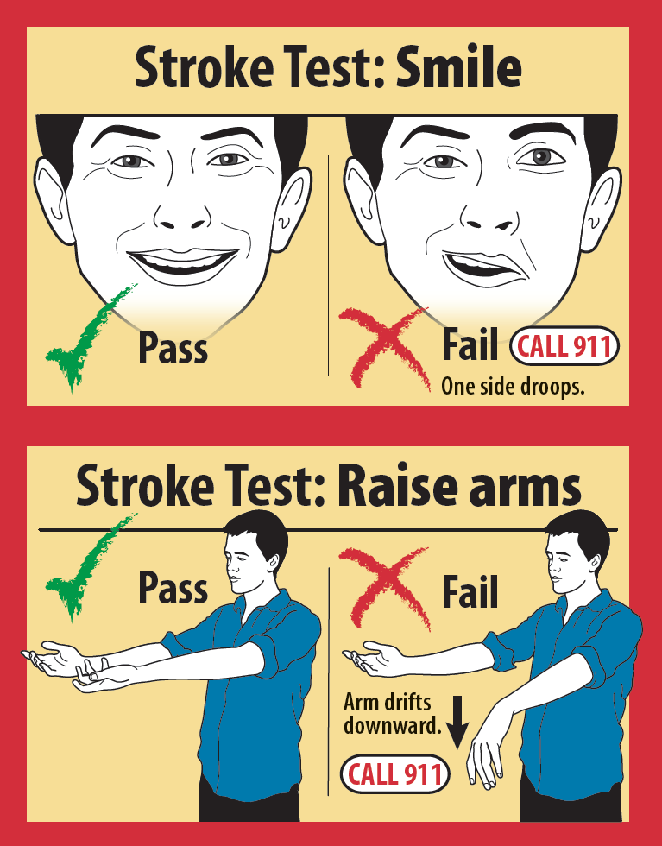
Free Resources
Simple, easy guidance of how to spot as stroke, stop a stroke and save a life are available for FREE download. Flyers, wallet cards, and links to other resources are also available.
If each of you tells just one person, you will make a difference.
Visit: miemss.org/home/hospitals/stroke-resources/stay-stroke-smart

