Slide 1
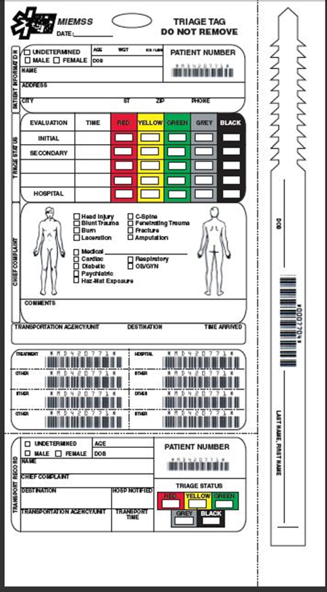
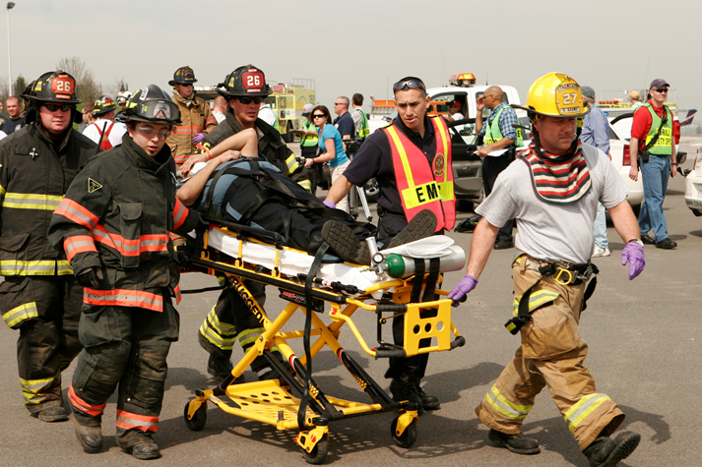
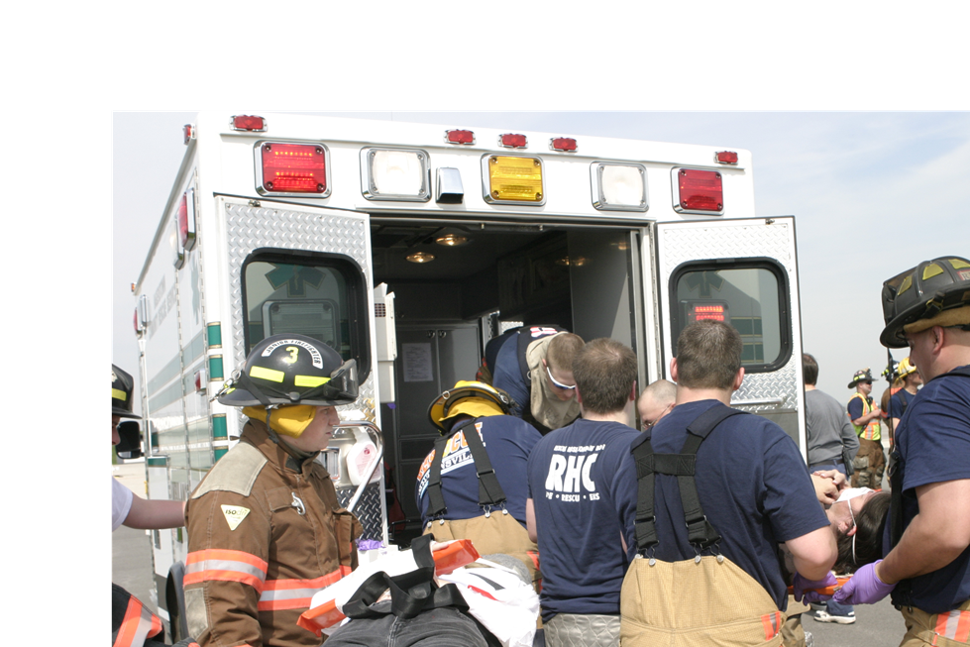
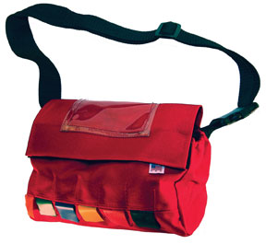
Maryland Triage System Tag, START, and JumpSTART
JAN 2019
Notes:
INSTRUCTOR NOTES:
Introduction slide. The program may be taught in a group setting or self-taught.

Slide 2
Enabling Objectives
Upon completion of this training the participant
will be able to:
Define TRIAGE and explain when it is appropriate for use
List three reasons a patient triage and tracking system is required for successful operations
Categorize the Triage status of patients utilizing the START and JumpSTART Triage Systems
Explain the design and use of paper Triage Tags
Identify five capabilities of the paper Maryland Triage Tags
Notes:
INSTRUCTOR NOTES:
Enabling objectives define the specific knowledge, skills, and/or abilities to be demonstrated, compared, listed, described, etc.

Slide 3
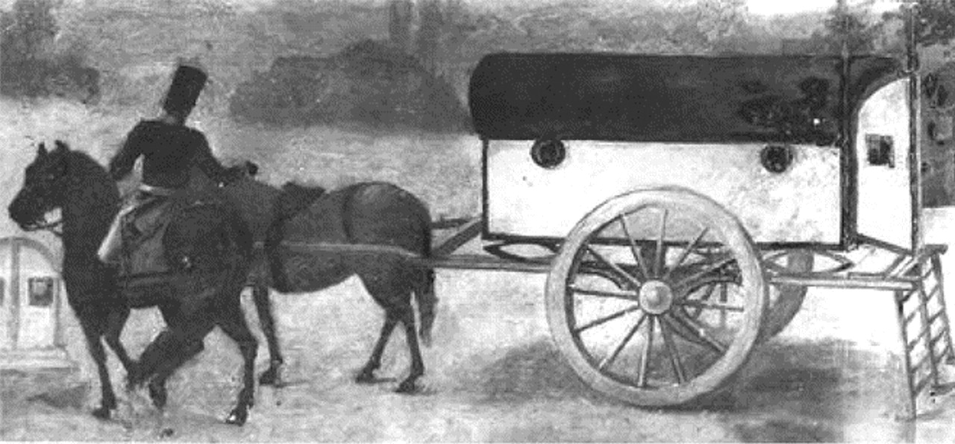
Triage
The sorting of and allocation of treatment to patients and especially battle and disaster victims according to a system of priorities designed to maximize the number of survivors
(from the French trier, to sort)
(Merriam-Webster)
Developed by Baron Dominique-Jean Larrey, Napoleon's Chief Surgeon, for use by the first ambulance corps—the ambulances volantes—during the early 1800s

Slide 4
Why Triage and Tag?
Sorting of patients to provide for the survival of the most patients
Assignment of resources in the most efficient method
Most severe survivable injuries receive rapid treatment
Accountability of patients
Family reunification

Slide 5
Triage Unit Leader
Triage: A rapid approach to prioritizing
a large number of patients
Casualty
Collection
Point
Simple Triage And Rapid Treatment
Incident Site
JumpSTART
Notes:
INSTRUCTOR NOTES:
This subject matter should be familiar to the student and is provided here as both a brief refresher and to tie together the components of the training program.

Slide 6
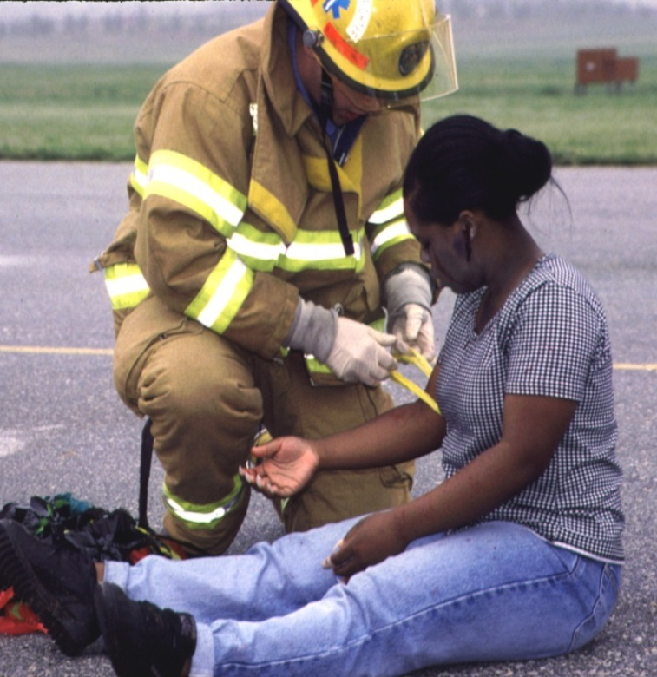
Triage
Triage should be performed RAPIDLY
Utilize START/ JumpSTART Triage to determine priority
15–60 seconds per patient
Affix a color tape on upper arm or leg
Notes:
INSTRUCTOR NOTES:
MOVE QUICKLY!
Use S.T.A.R.T. to determine the priority of the patient:
No more than 15–60 seconds per patient
Check:
Respiration
Pulse
Mental Status
Attach ribbon to UPPER ARM, if possible. The next option would be HIGH on a THIGH. The goal is to be consistent so they are easily recognized as the priority flag.

Slide 7
START – JumpSTART Triage
Clear the “walking wounded” with verbal instruction:
If you can hear me and you can move, walk to…
Direct patients to the casualty collection point (CCP) or treatment area for detailed assessment and medical care
Assign a Green Minor Manager to the area to control patients and manage area
Tag will be issued at the CCP
These patients may be classified as MINOR
Notes:
INSTRUCTOR NOTES:
Talk the students through the triage process using these guidelines. Essentially, if a patient can hear you, understand and follow your commands, and has the physical ability to walk on their own, their injuries are non-emergent and can be tended to later. Of course, triage is a dynamic process and these patients should be re-assessed at the treatment area for any deterioration in their condition. The action of moving the MINOR patients from the scene also helps clear space and reduce confusion so the remaining patients can be quickly categorized.

Slide 8
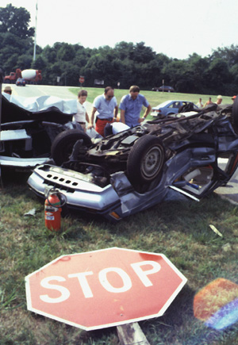
START/JumpSTART
Now use START/JumpSTART to assess and categorize the remaining patients…
USE COLORED RIBBONS ONLY
Notes:
INSTRUCTOR NOTES:
Basic, quick patient care

Slide 9
START/JumpSTART
Categorize the patients by assessing each patient’s RPMs…
Respirations
Pulse/perfusion
Mental Status
Notes:
INSTRUCTOR NOTES:
These are the three decision criteria to be used in categorizing those patients who have not already been determined to be “walking wounded.”

Slide 10
START/JumpSTART—RPM
RESPIRATIONS
Is the patient breathing?
Yes
Adult – respirations > 30 = Red/Immediate
Pediatric – respirations < 15 or > 45 = Red/Immediate
Adult – respirations < 30 = check perfusion
Pediatric – respirations > 15 and < 45 = check perfusion
Notes:
INSTRUCTOR NOTES:
Address respirations first. Many triage decisions can be made on this assessment alone. This corresponds to the “A” and “B” of the ABCs of patient care.

Slide 11
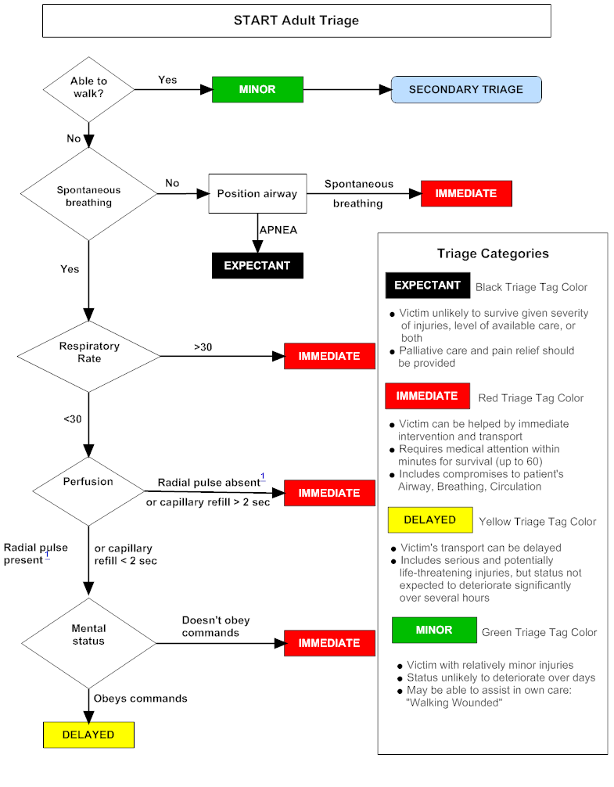
START/JumpSTART—RPM
RESPIRATIONS
Is the patient breathing?
No
Reposition the airway…
Respirations begin = IMMEDIATE/RED
If patient is APNEIC
Adult – deceased = BLACK
Pediatric: Pulse Present – give 5 rescue breaths
respirations begin = IMMEDIATE/RED
absent respirations – deceased = BLACK
Notes:
INSTRUCTOR NOTES:
Address respirations first. Many triage decisions can be made on this assessment alone. This corresponds to the “A” and “B” of the ABCs of patient care.
11

Slide 12
START/JumpSTART—RPM
PULSE/PERFUSION
Is the RADIAL pulse present?
Is capillary refill (CR) LESS than < 2 seconds?
Yes
Check mental status
No
Adult: Pulse absent or CR > 2 seconds patient = IMMEDIATE/RED
Pediatric: No palpable pulse patient = IMMEDIATE/RED
Notes:
INSTRUCTOR NOTES:
This assessment corresponds to the “C” of the ABCs.

Slide 13
START/JumpSTART—RPM
MENTAL STATUS…
Can the patient follow simple commands?
Yes
Adult = DELAYED / YELLOW
Pediatric: alert, verbal, or pain response is appropriate
= DELAYED / YELLOW
No
Adult = IMMEDIATE / RED
Pediatric – “P” pain causes inappropriate posturing or “U” unresponsive to noxious stimuli = IMMEDIATE/ RED
Notes:
INSTRUCTOR NOTES:
Patients that have respirations more than 30/minute and capillary refill greater than 2 seconds, but who can follow commands, are still categorized as IMMEDIATE.

Slide 14
START/JumpSTART
If the patient is IMMEDIATE/RED upon initial assessment…then, before moving the patient to the treatment area, attempt only life-saving interventions:
Airway, Needle Decompression, Tourniquet, Antidote
DO NOT ATTEMPT ANY OTHER
TREATMENT AT THIS TIME
Notes:
INSTRUCTOR NOTES:
Only emergent and immediately life-saving interventions should be performed at this stage. All other interventions should be made at the treatment area.

Slide 15
Combined START/JumpSTART Triage
CAN YOU
YES
MINOR
SECONDARY TRIAGE
**
**
Using the JS algorithm
WALK
?
evaluate all children first
who did not walk under
NO
their own power.
BREATHING
Evaluate infants first in
Breathing
?
NO
Position Upper Airway
IMMEDIATE
secondary triage using
entire JS algorithm
!
APNEIC
ADULT
PEDIATRIC
HAS A
NO PULSE
PULSE
APNEIC
PEDI Neurological Assessment
YES
5 Rescue Breaths
Expected /
Deceased
A
Alert
BREATHING
Responds to
IMMEDIATE
V
Verbal Stimuli
>
30
ADULT
P
Responds to
Respiratory
IMMEDIATE
Painful Stimuli
Rate
?
45 > OR < 15
PEDI
Unresponsive
<
30
ADULT
U
To Noxious
15
-
45
PEDI
ADULT
CR >2 Sec or NO PALPABLE PULSE
Stimuli
Perfusion
?
IMMEDIATE
PEDI - NO PALPABLE PULSE
YES
“P” INAPPROPRIATE POSTURING OR “U”
DOESN’T OBEY COMMANDS
(
PEDIATRIC
)
Mental
IMMEDIATE
Status
?
ADULT
OBEY COMMANDS
-
ADULT
DELAYED
“A”
,
“V”
,
OR “P”
)
PEDIATRIC
(
APPROPRIATE
-
Http
://
www
.
starttriage
.
com
Http
://
www
.
jumpstarttriage
.
com
Notes:
This is the combination START/JumpSTART algorithm. Separate START and JumpSTART algorithms are located at the end of this slide show, but hidden from the regular slide show.

Slide 16
Fast Triage – Ribbon Applied First
Apply ribbon to upper arm or upper thigh
Notes:
INSTRUCTOR NOTES:
The first round of patient contact will be performed in triage and category designation made with the colored ribbon.

Slide 17
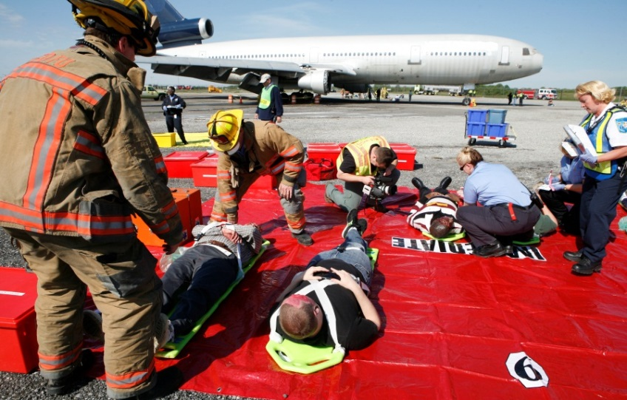
RED Triage Category (Immediate)
Adult
Respirations > 30 BPM
CR > 2 seconds or
no palpable radial pulse
Cannot follow simple
commands
Pneumothorax
Hemorrhagic Shock
Closed Head Injury
Pediatric
Respirations < 15 or > 45
CR > 2 seconds or no palpable radial or brachial pulse
Inappropriate “Pain”
(e.g., posturing) or “Unresponsive”
Notes:
INSTRUCTOR NOTES:
The RED category is also referred to as IMMEDIATE and follows START criteria.
Requires medical attention within minutes for survival (up to 60 minutes)
Victim can be helped by immediate intervention and transport
Includes compromises to patient’s Airway, Breathing and Circulation

Slide 18
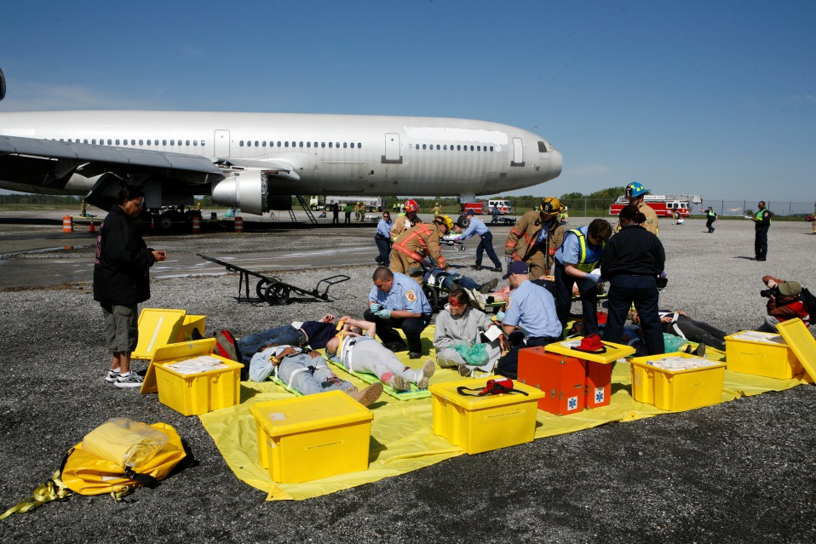
YELLOW Triage Category (Delayed)
Adult: respirations, capillary refill, and mentation are normal
Isolated burns
Extremity fractures
Stable other trauma
Most patients with medical complaints
Pediatric: “A,” “V,” or appropriate “P”
(e.g., withdrawal from pain stimulus)
Notes:
INSTRUCTOR NOTES:
The YELLOW category is also referred to as DELAYED.
• Victim’s transport can be delayed
Includes serious and potentially life-threatening injuries, but status not expected to deteriorate significantly over several hours

Slide 19
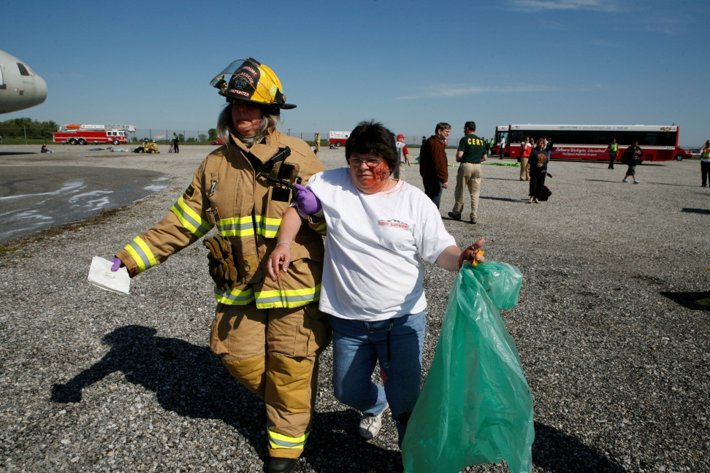
GREEN Triage Category (Minor)
“Walking wounded”
Psychological casualties
Always look for children being carried and assess them
Notes:
INSTRUCTOR NOTES:
The GREEN category is also referred to as MINOR.
Victim with relatively minor injuries
Status unlikely to deteriorate over days
May be able to assist in own care
“Walking Wounded”

Slide 20
BLACK Triage Category (Deceased)
Obvious mortality or death (pulseless and apneic)
Decapitation
Blunt trauma arrest
Injuries incompatible with life
Brain matter visible
Notes:
INSTRUCTOR NOTES:
The BLACK category is for DECEASED or patients EXPECTED to die.
Victim unlikely to survive given severity of injuries, level of available care, or both
Palliative care and pain relief should be provided

Slide 21
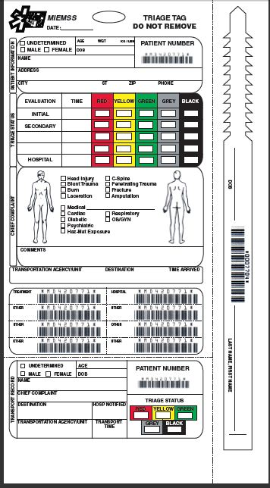
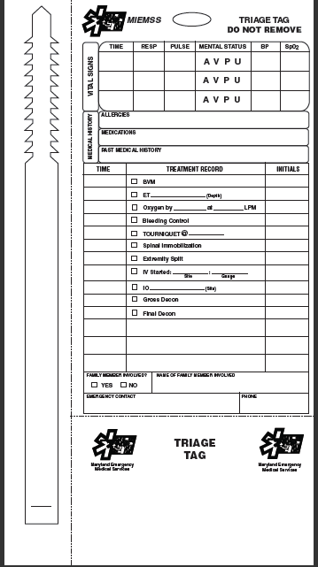
Revised Paper Triage Tag
FRONT
BACK
Do Not Use Gray Category
Notes:
INSTRUCTOR NOTES:
The triage tags now have a GREY triage status category. This category is not currently approved for use but is printed on the tag in anticipation of its approval for use in the future. The paper tags have a tear off wrist/ankle tag on the right side (when viewed from the front) that have a bar code for use in patient tracking should the triage tag become separated from the patient.

Slide 22
Triage Tag Sections
Patient information
Triage status
Chief complaint
Transporting unit
Peel-off bar codes
Transport record
Vital signs
Medical history
Treatment
Family contact
Wrist band
* Triage tags should be used in all MCI scenarios, even when handheld device is employed
Notes:
INSTRUCTOR NOTES:
These are the different sections of the triage tags.

Slide 23
Patient information
Triage status
Chief complaint
Transporting unit
Peel-off bar codes
Transport record
Vital signs
Medical history
Treatment
Family contact
Wrist band
Notes:
INSTRUCTOR NOTES:
This information is important not only for patient identification but can also help with family reunification. Frequently, the urgency of the situation prevents obtaining this information “up front.” It can be entered when time allows.

Slide 24
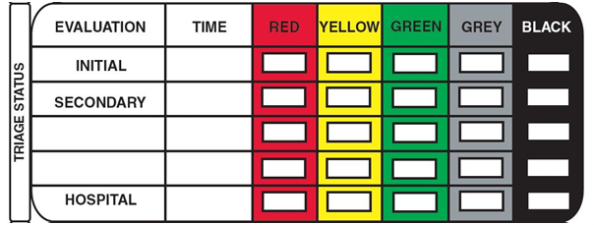
The paper triage tag includes a GREY category for future use based on anticipated national acceptance.
IT WILL NOT BE USED IN THE TRIAGE OF PATIENTS UNTIL APPROVED BY MIEMSS.
Patient information
TRIAGE STATUS
Chief complaint
Transporting unit
Peel-off bar codes
Transport record
Vital signs
Medical history
Treatment
Family contact
Wrist band
Notes:
INSTRUCTOR NOTES:
Tags with a GREY category are in use but the category itself has not been approved for use in the triage of patients.

Slide 25
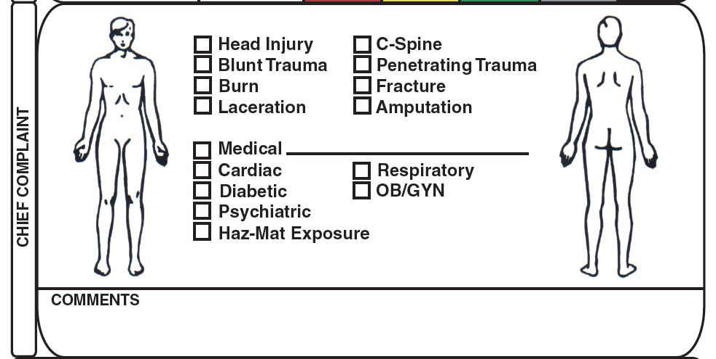
Patient information
Triage status
CHIEF COMPLAINT
Transporting unit
Peel-off bar codes
Transport record
Vital signs
Medical history
Treatment
Family contact
Wrist band
Notes:
INSTRUCTOR NOTES:
The Chief Complaint section allows for the categorization of trauma or medical illness along with the opportunity to note the body part or region involved. The Comment section provides the opportunity to include additional or more specific information. For example, the burn category is demarcated by a circle and/or “X,” but you can describe the burns as first, second, or third degree in the comments section.

Slide 26
Patient information
Triage status
Chief complaint
TRANSPORTING UNIT
Peel-off bar codes
Transport record
Vital signs
Medical history
Treatment
Family contact
Wrist band
Notes:
INSTRUCTOR NOTES:
This section is filled out by Transportation Group Supervisor or Ambulance Disposition Coordinator or designee.

Slide 27
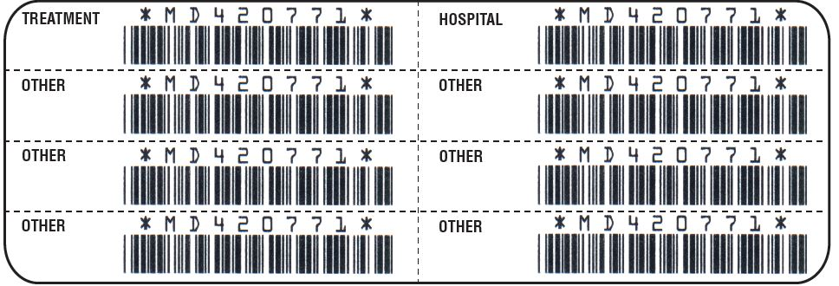
Patient information
Triage status
Chief complaint
Transporting unit
PEEL-OFF BAR CODES
Transport record
Vital signs
Medical history
Treatment
Family contact
Wrist band
Notes:
INSTRUCTOR NOTES:
The peel off bar codes are to be utilized to track a patient through the triage and transport process. They can also be used to identify and track patient belongings.

Slide 28
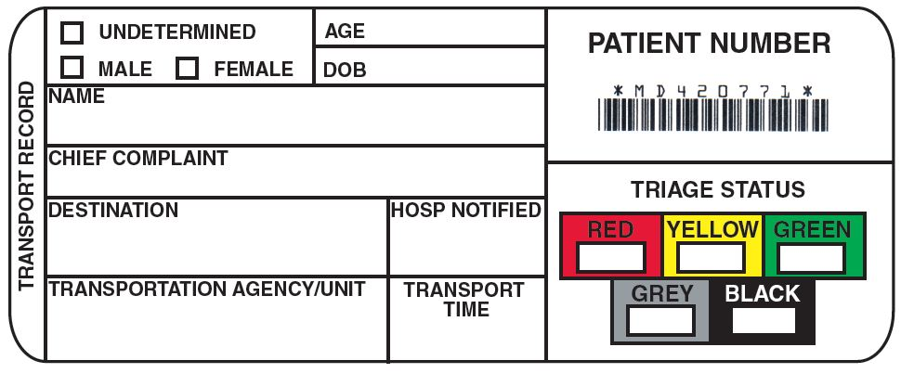
Detachable as a tear-off and as a peel-off sticky label
Used to document patient movement
Must be affixed to Transport Tactical Worksheet with the unit, priority, and destination marked and initialed.
Commonly called the “Ticket”
Patient information
Triage status
Chief complaint
Transporting unit
Peel-off bar codes
TRANSPORT RECORD
Vital signs
Medical history
Treatment
Family contact
Wrist band
Notes:
INSTRUCTOR NOTES:
This section has come to be known as the “Ticket” and contains a synopsis of the patient’s personal information, medical status, and transport history.

Slide 29
Removable wrist band has been added with an area for DOB and name
Patient information
Triage status
Chief complaint
Transporting unit
Peel-off bar codes
Transport record
Vital signs
Medical history
Treatment
Family contact
WRIST BAND
Notes:
INSTRUCTOR NOTES:
This is the new removable wrist band. It can be placed on the patient to assist with patient processing..
29

Slide 30
Patient information
Triage status
Chief complaint
Transporting unit
Peel-off bar codes
Transport record
VITAL SIGNS
Medical history
Treatment
Family contact
Wrist band
Notes:
INSTRUCTOR NOTES:
This section allows the care provider to sequentially document the R(espiration), P(ulse), and M(ental status) critical to the START (Simple Triage And Rapid Treatment) and JumpSTART process described earlier.
Mental status is indicated by the common AVPU system: Alert, responsive to Verbal stimuli, responsive to Painful stimuli, or Unresponsive.
Blood pressure and oxygen saturation, while not part of the START process, provide information that can help in making decisions for medical care.
There are three sections to allow information to be recorded at different times. After all, triage is a dynamic process.

Slide 31
Patient information
Triage status
Chief complaint
Transporting unit
Peel-off bar codes
Transport record
Vital signs
MEDICAL HISTORY
Treatment
Family contact
Wrist band
Notes:
INSTRUCTOR NOTES:
Medical history is usually obtained as time allows.

Slide 32
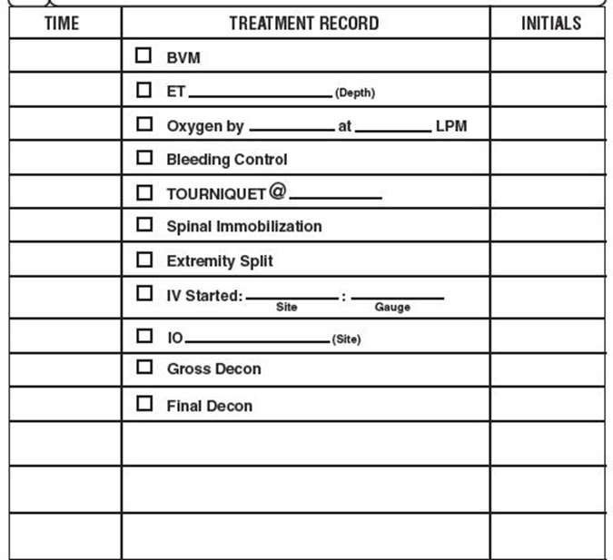
Patient information
Triage status
Chief complaint
Transporting unit
Peel-off bar codes
Transport record
Vital signs
Medical history
TREATMENT
Family contact
Wrist band
Notes:
INSTRUCTOR NOTES:
This section allows for the documentation of the treatments provided by multiple providers at different times in the patient’s course of care. Timed delivery of care is especially important for something like tourniquet application.

Slide 33
Patient information
Triage status
Chief complaint
Transporting unit
Peel-off bar codes
Transport record
Vital signs
Medical history
Treatment
FAMILY CONTACT
Wrist band
Notes:
INSTRUCTOR NOTES:
This information is also critical to family reunification efforts.

Slide 34
Triage Summary
Triage allows for effective and efficient care, helping to increase the survivability for as many patients as possible
Assignment of resources will increase efficiency
Most severely injured patients will receive rapid treatment and transport in logical order
Ensures accountability of all patients
Allows for family reunification

Slide 36
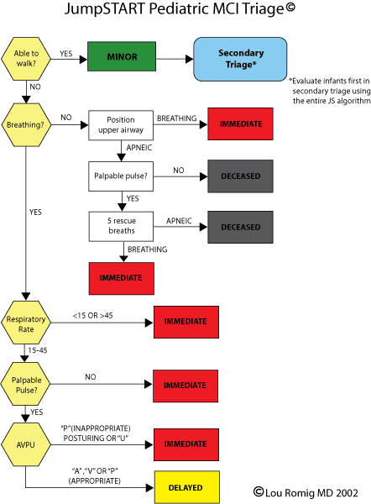

Slide 37
Maryland Triage System
MIEMSS gratefully acknowledges the following individuals for their efforts in the development of this program:

Slide 38
Maryland Triage System
Maryland Institute for
Emergency Medical Services Systems
653 West Pratt Street
Baltimore, MD 21201
410-706-3996

